Slide 1
Artist House
.balance.
Cecelia Kominsky

Slide 2
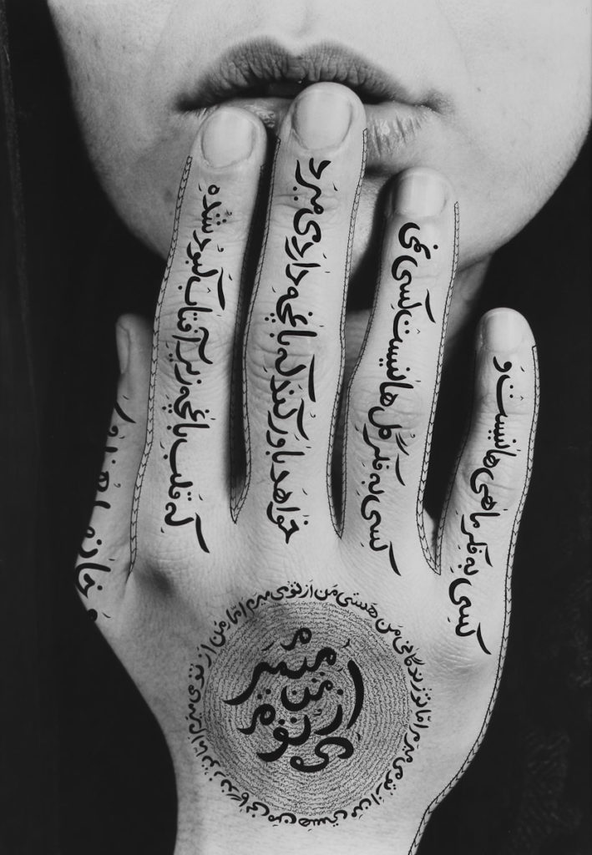
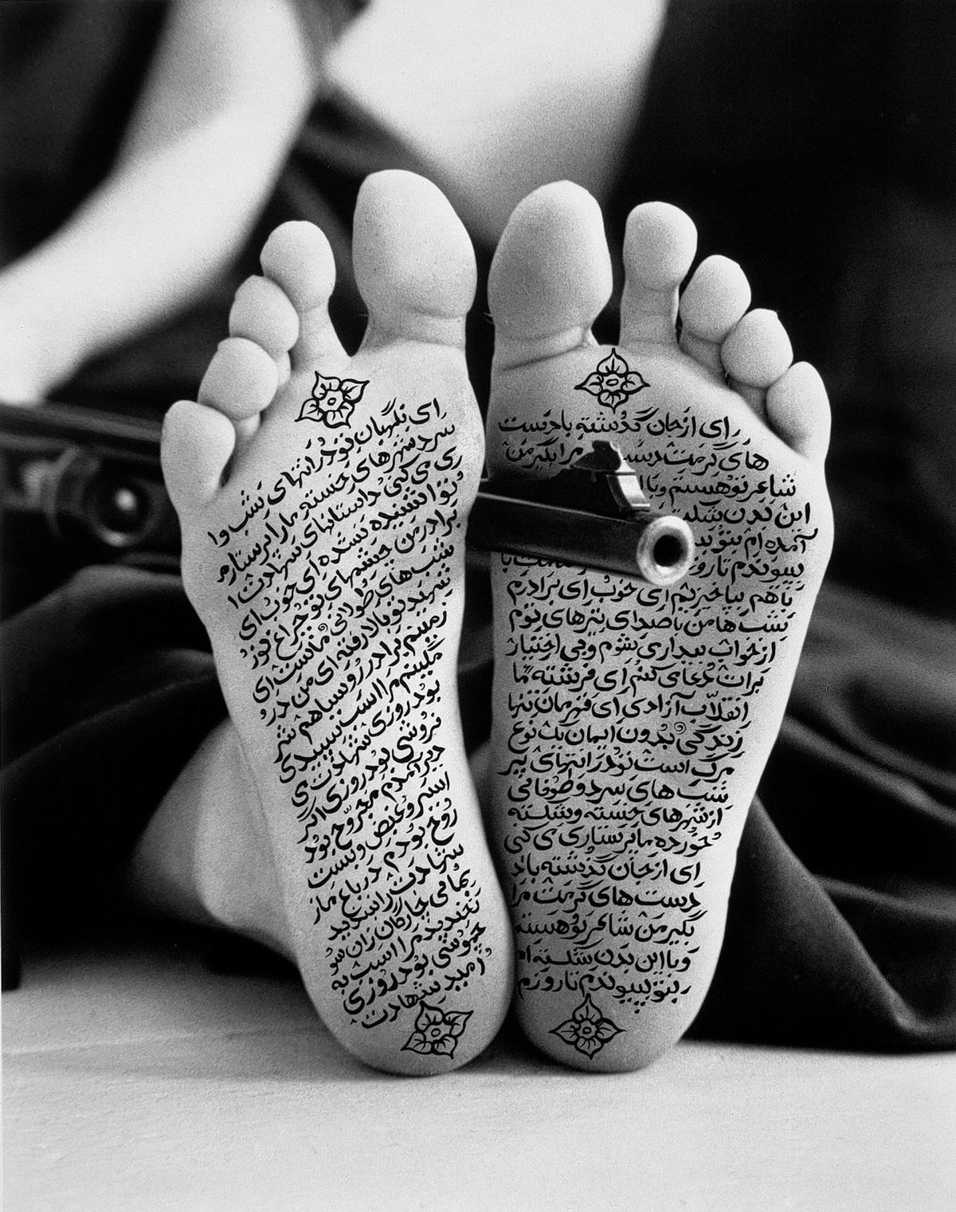
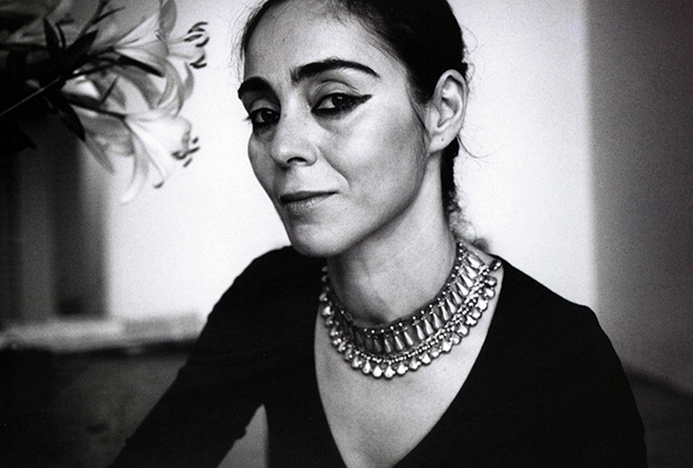
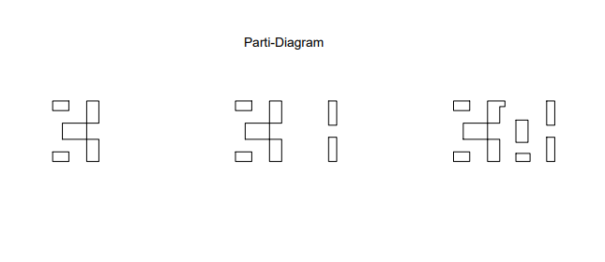
CONCEPT
Shirin Neshat is an Iranian visual artist who lives in New York City, known primarily for her work in film, video and photography. Her artwork centers on the contrasts between Islam and the West, femininity and masculinity, public life and private life, antiquity and modernity, and bridging the spaces between these subjects. While she doesn’t consider herself as an activist much of her artwork portrayed an expression of protest for human rights and equality.
I noticed that a lot of her artwork and photographs are black and white and feature parts of the human body which I would like to incorporate into my house design.
Balance
Shirin Neshat

Slide 3
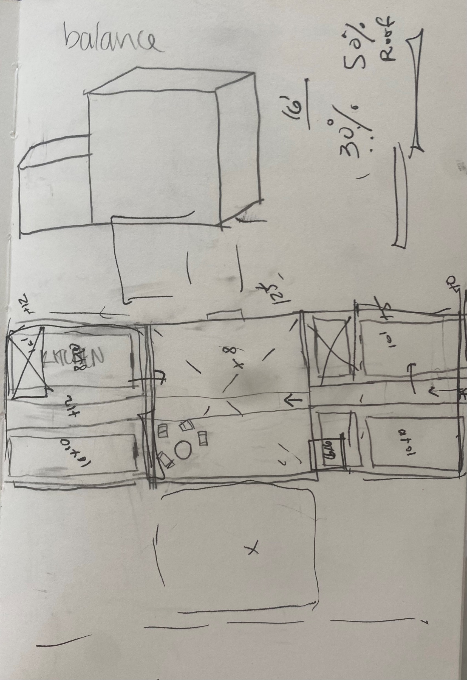
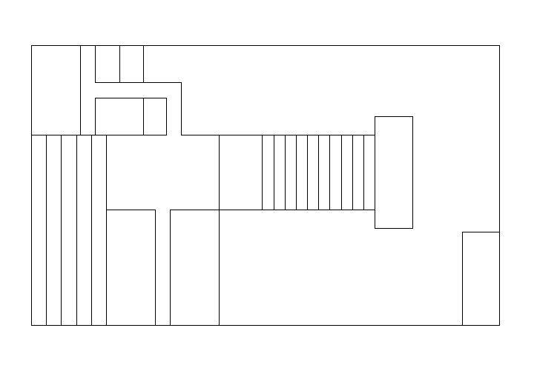
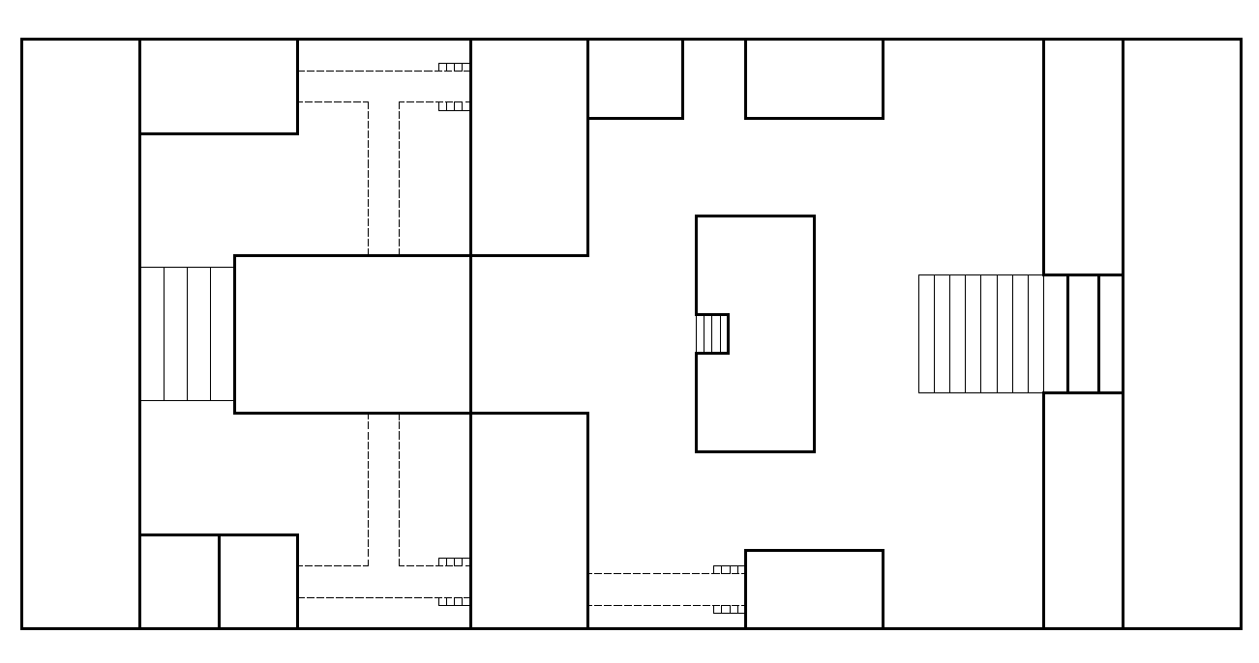
PROCESS

Slide 4
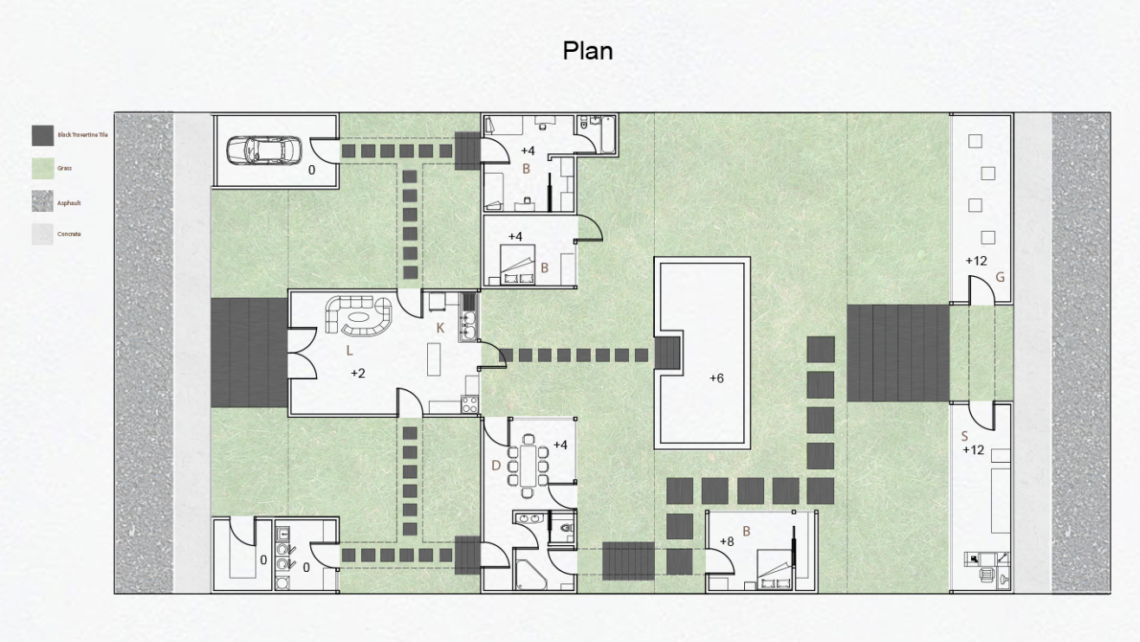



PLAN
A
C
B
B
A
C

Slide 5
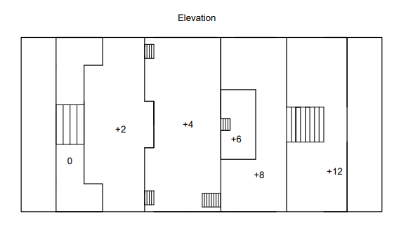
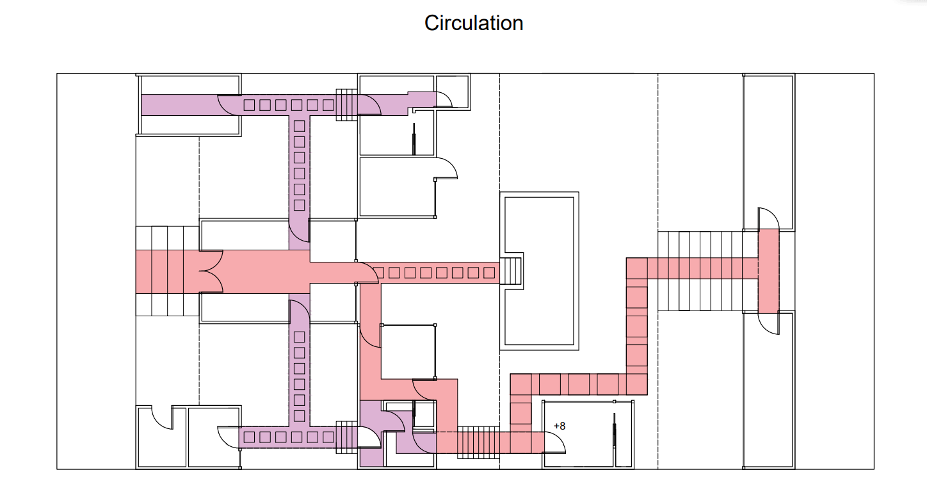
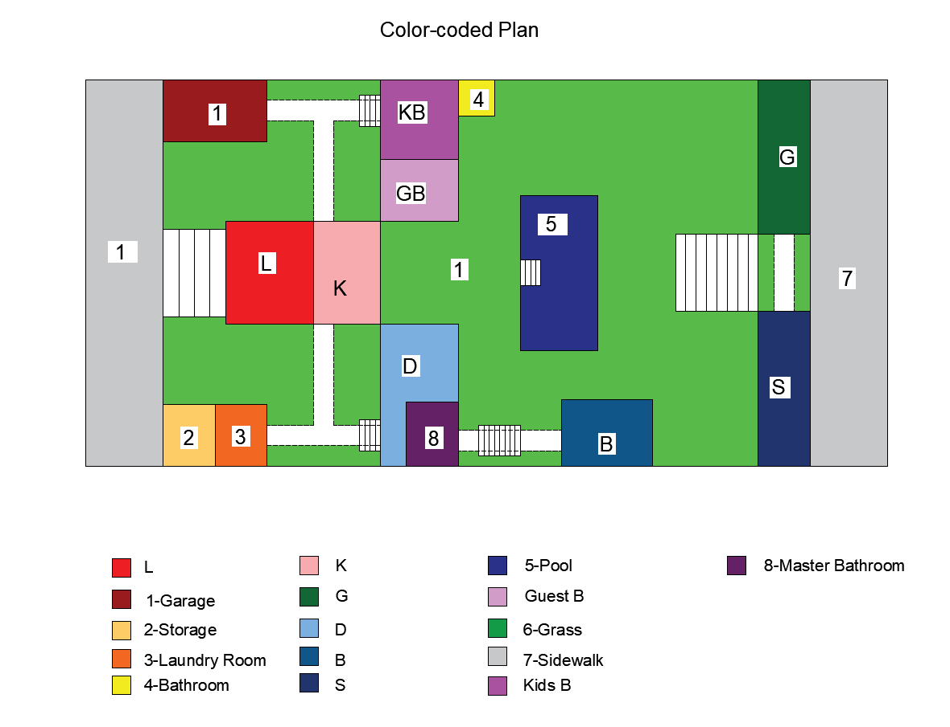
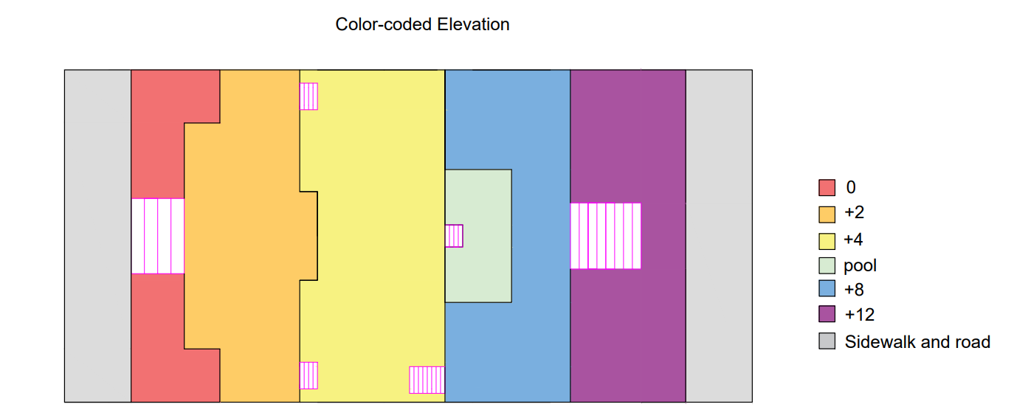
PLAN

Slide 6

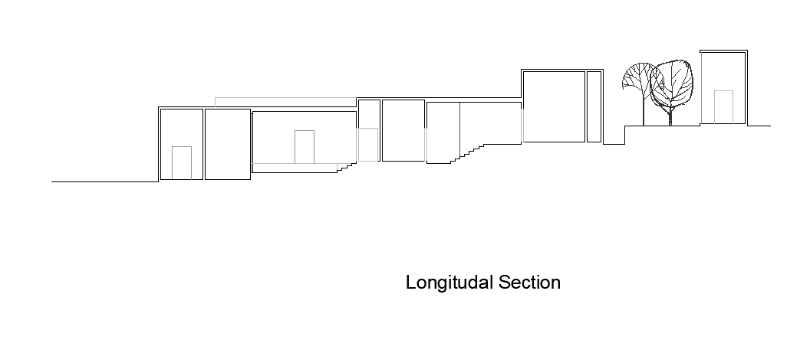
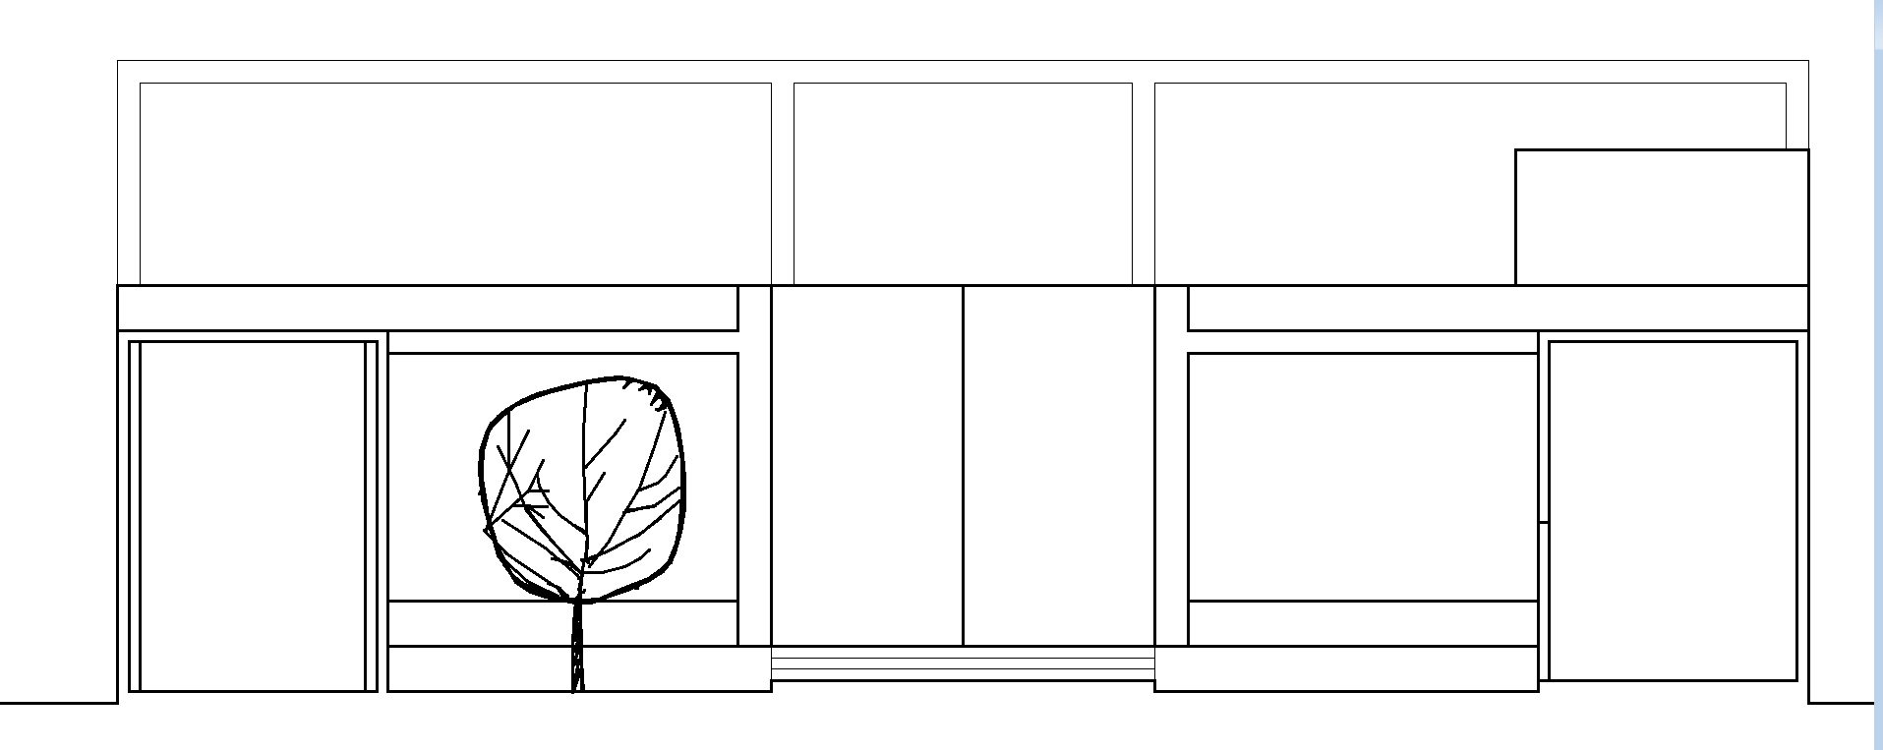



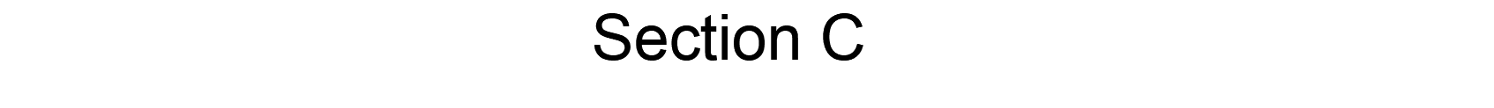
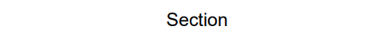

SECTIONS
A
B

Slide 7

SECTIONS

Slide 8
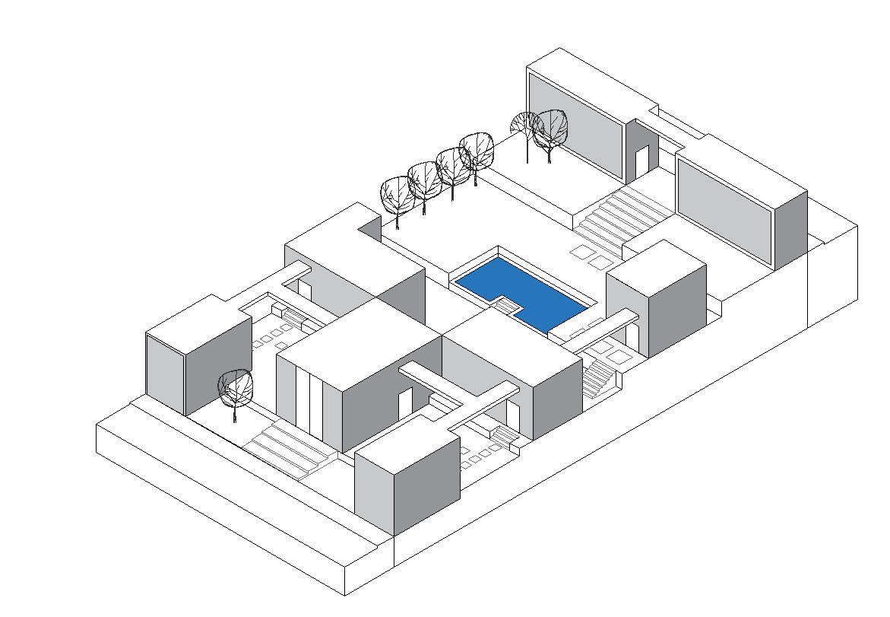
ISOMETRIC

Slide 9
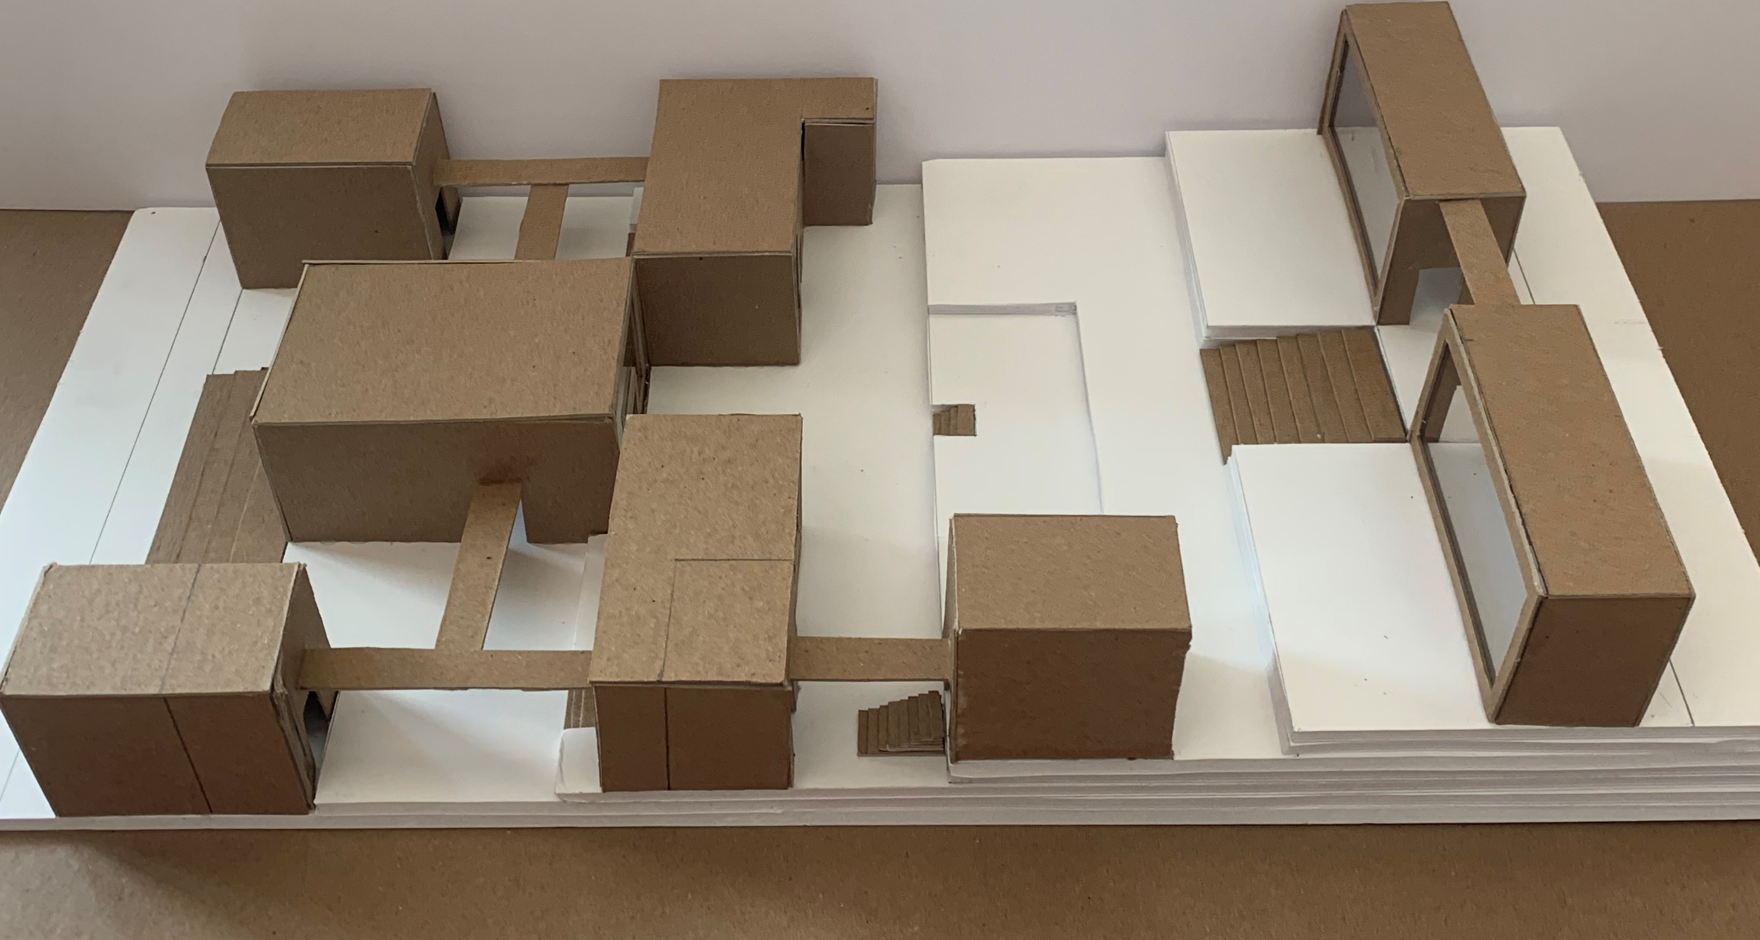
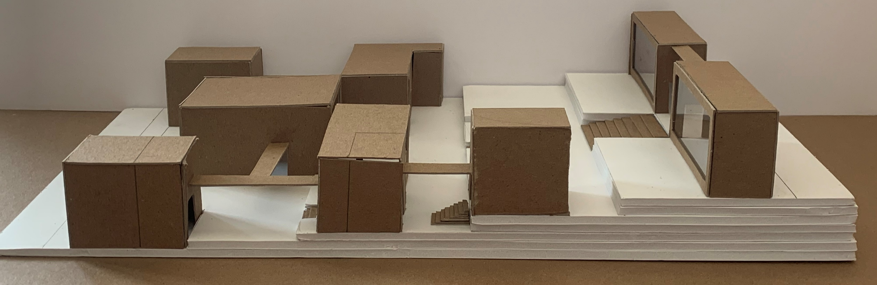
MODEL PICS

Slide 10
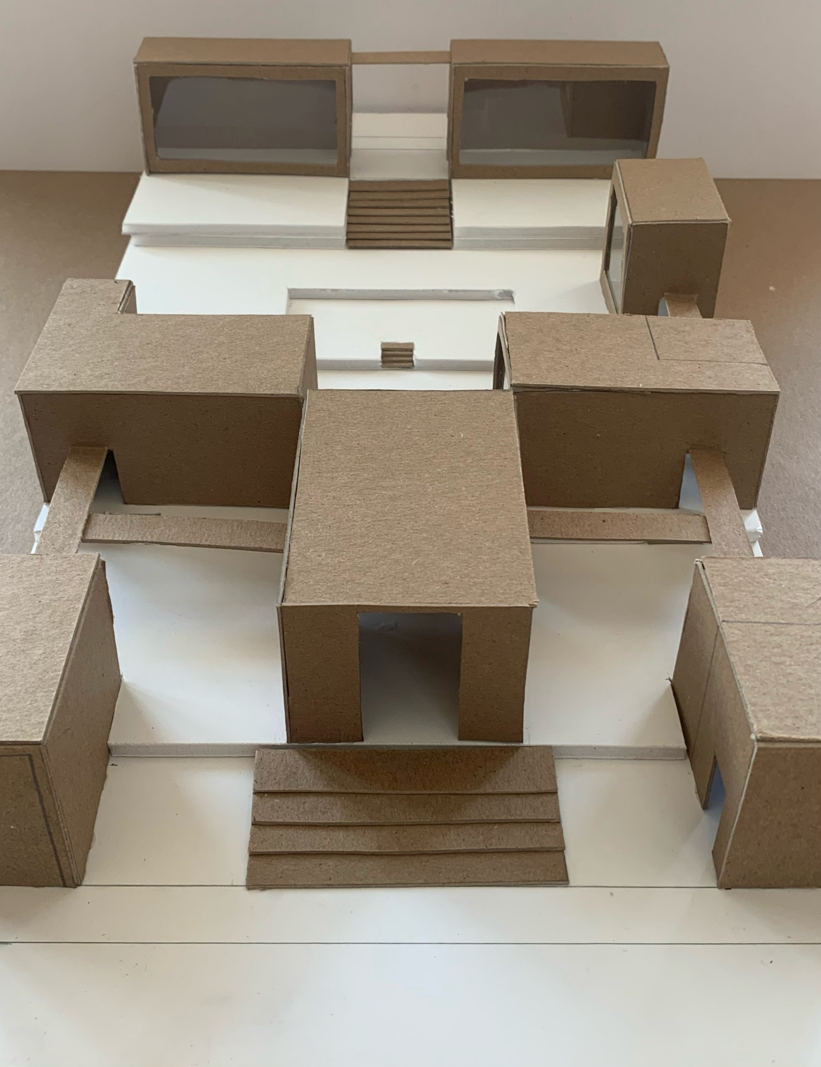
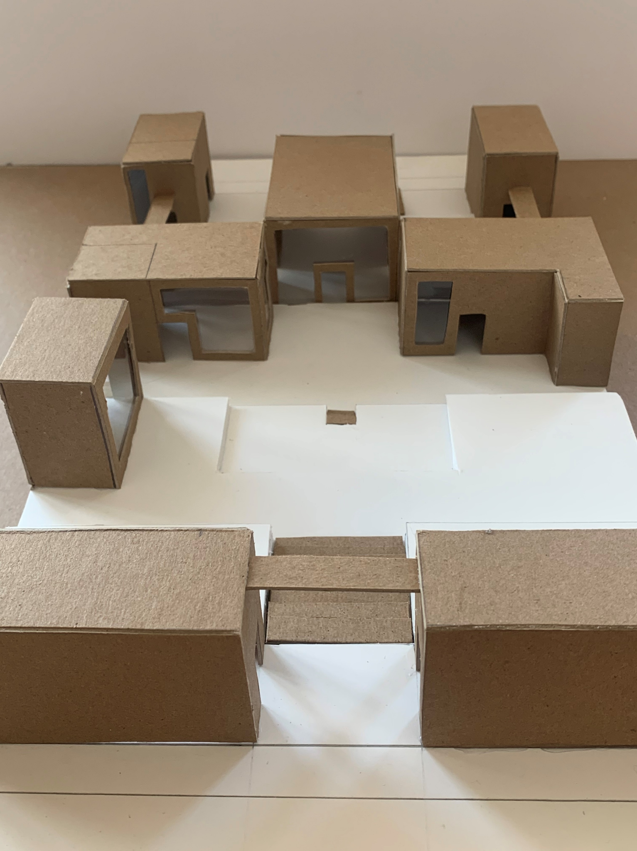
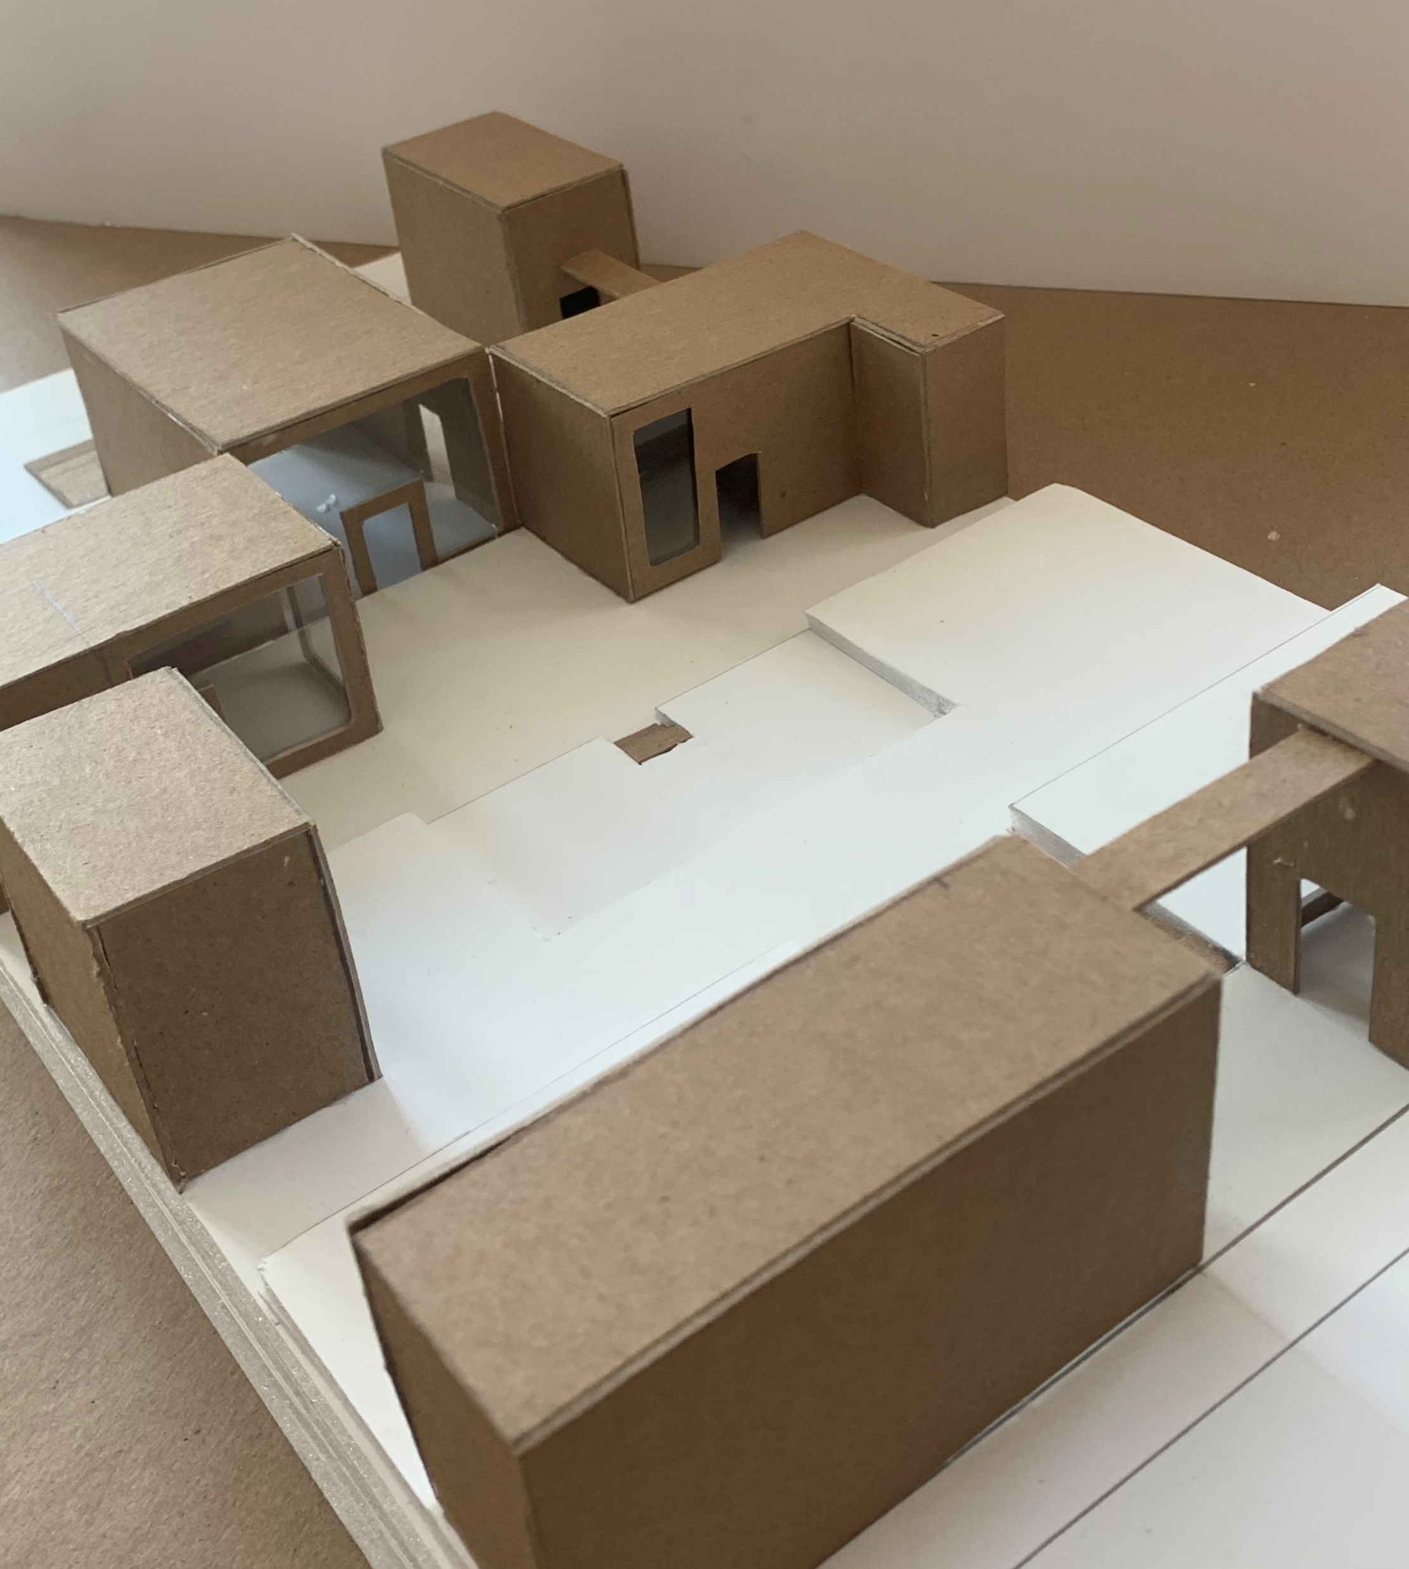
MODEL PICS

Slide 11
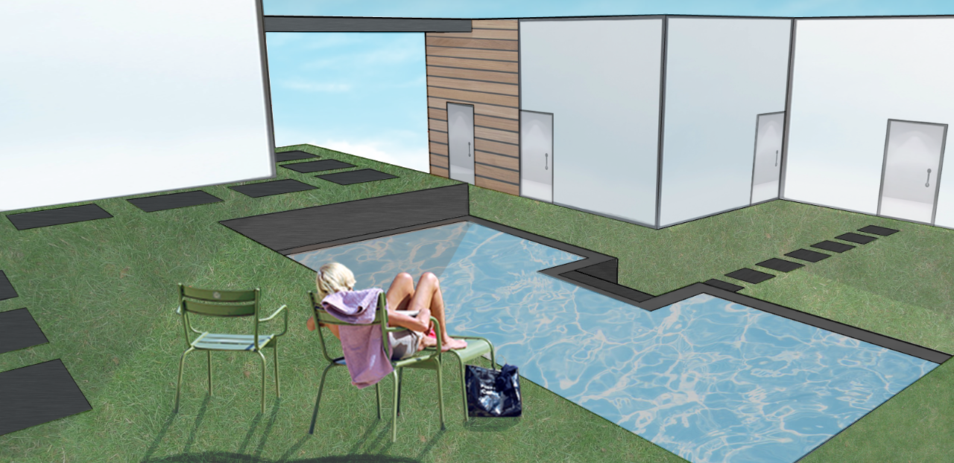
MODEL RENDERING

